Slide 1
CSC 536 Lecture 10

Slide 2
Outline
Case studies
Bitcoin and blockchains
CRDTs

Slide 3
Bitcoin and blockchains
http://reed.cs.depaul.edu/lperkovic/csc536/lecture10/bitcoin.pdf

Slide 4


Basics: Digital Signature
Signing
Verification
Key Generation
Bob
Alice (Public)
Alice (Secret)
Alice

Slide 5
Digital Signature
Signing
Verification
Key Generation
Alice (Public)
Alice (Secret)
Alice (Public)
Bob
Alice

Slide 6


Digital Signature
Goal: Bob should be sure that the message originates from Alice.
Signing
Verification
Key Generation
Alice (Public)
Bob
Message
Alice (Public)
Alice (Secret)
Alice
A

Slide 7
Attempt #1
We now try to build bitcoin…
… but we will fail.

Slide 8
Goals
We want some kind of “digital money”.
Everyone can participate.
No central instance – no bank.
Notes:
10 min so far.

Slide 9
Setting
A network of computers.
Every computer can send messages to some other computers.

Slide 10
Basic idea
Every computer maintains a table: “who owns what?”
Alice (Public)
10 BTC
Bob
(Public)
0.2 BTC
We will need: all computers have the same table (or ledger).
Charlie
(Public)
17 BTC
Dora
(Public)
0.001 BTC
Eliza
(Public)
2 BTC
Everyone knows exactly which bitcoins each participant has.

Slide 11
Sending Bitcoins
To send money, we use transactions. These are messages like this:
Transfer
0.1 BTC
from
Alice (Public)
In “short”, transactions look like this:
to
Bob
(Public)
A
$
F
T

Slide 12
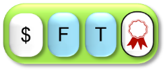
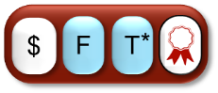
Main Transaction pic
$
F
T
$
F
T
*

Slide 13
Sending Bitcoins
I’LL send 0.1 Bitcoin to Bob.
$
F
T
Alice
Protocol: sending BTC
Craft a transaction.
Give it to your computer.
Protocol: participating
On valid transactions:
Update ledger
Relay transaction

Slide 14


Double Spending
Thanks!
I can exploit this!
These transactions spend previously spent bitcoins!
Bob
Thanks!
Black Hat
Black Hat prepares two transactions:
Alice
: Give BTC from Black Hat to Alice
: Give BTC from Black Hat to Bob

Slide 15

Double Spending
The bad guy spends the same Bitcoins with two
different transactions and .
Computers receiving transaction will have a different ledger than computers receiving transaction .

Slide 16
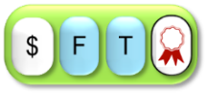
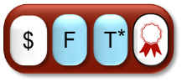
Consensus Protocols
We need a protocol to agree on a transaction.
Main idea for protocols:
What transaction are you using?
Protocols work if (say) > 70% of the computers follow the protocol.

Slide 17
This solution does not help us!
Design goal:
Everyone can participate.
By running a special program, a bad guy controls many virtual computers.
Like this, he can make different participants believe different things.
I will gladly participate…
With 1 000 virtual machines!

Slide 18
This solution does not help us!
Design goal:
Everyone can participate.
Solution:
Require participants to expend real resources
I will gladly participate…
With 1 000 virtual machines!

Slide 19
Bitcoin’s consensus protocol
Step 1: How does the protocol look like?
Step 2: What happens if people cheat?

Slide 20

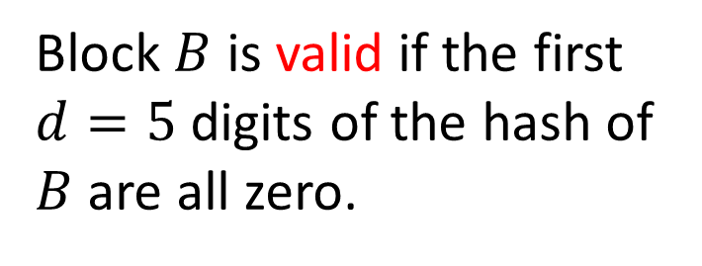
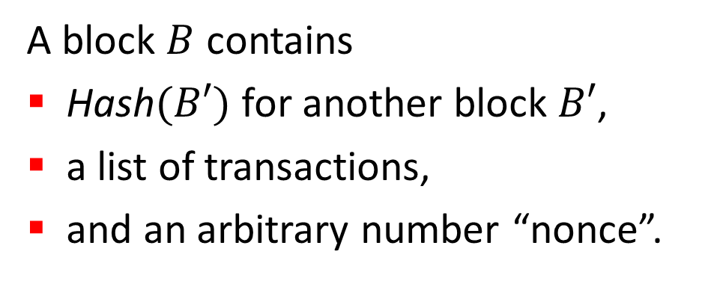
Blocks
A block $B$ contains
$\text{Hash}(B′)$ for another block $B′$,
a list of transactions,
and an arbitrary number “nonce”.
0000031105830
8046465385222
Block $B$ is valid if the first $d=5$ digits of the hash of $B$ are all zero.
RH
0000077326777

Slide 21
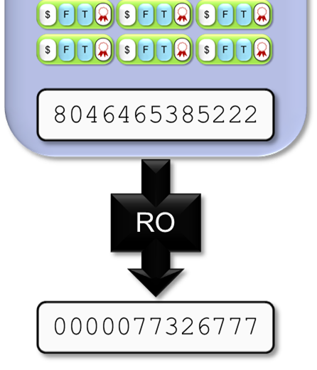
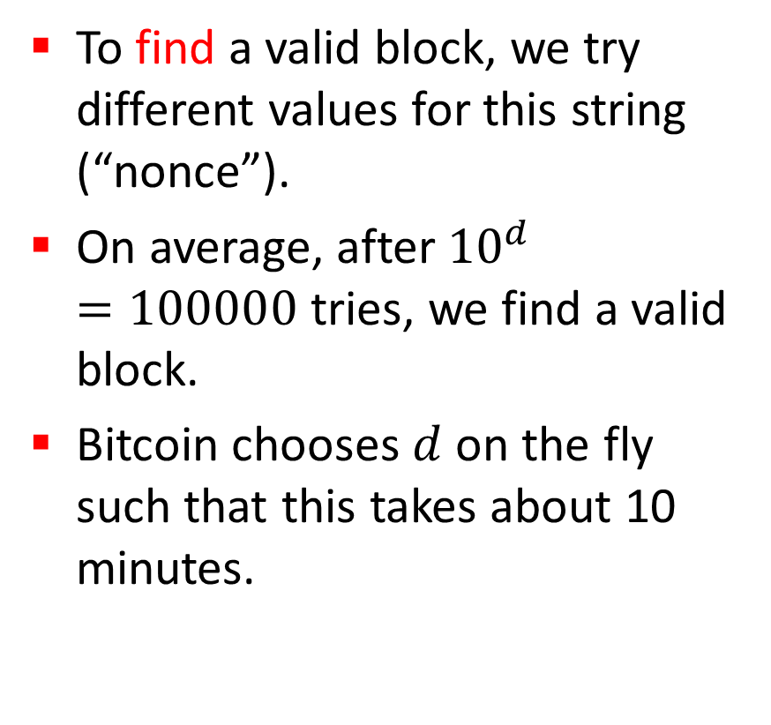
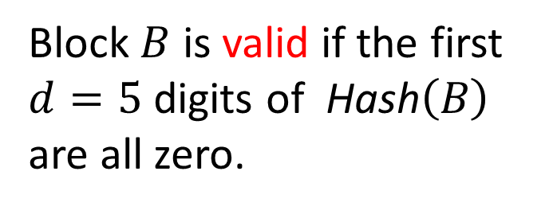
Blocks
To find a valid block, we try different values for this string (“nonce”).
On average, after ${10}^{d}=100000$ tries, we find a valid block.
Bitcoin chooses $d$ on the fly such that this takes about 10 minutes.
Block $B$ is valid if the first $d=5$ digits of $\text{H}\text{ash}\left(B\right)$ are all zero.

Slide 22
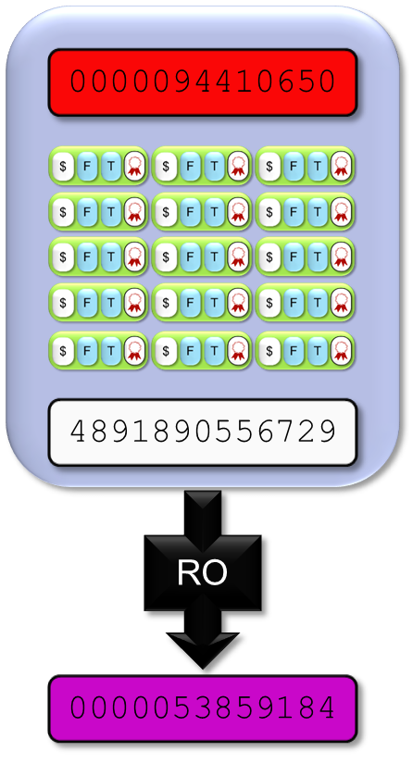

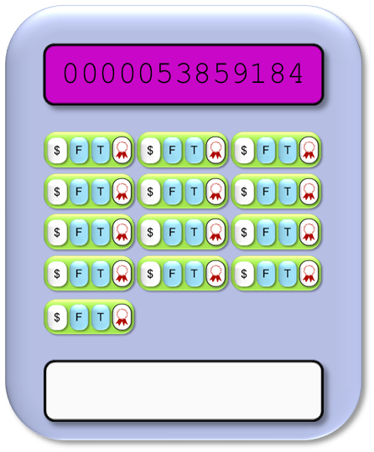
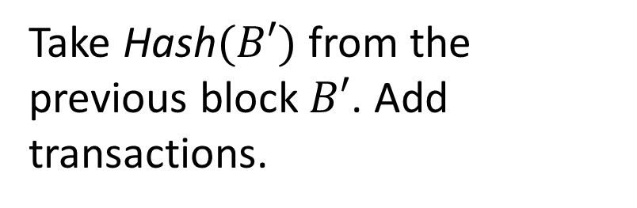
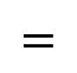
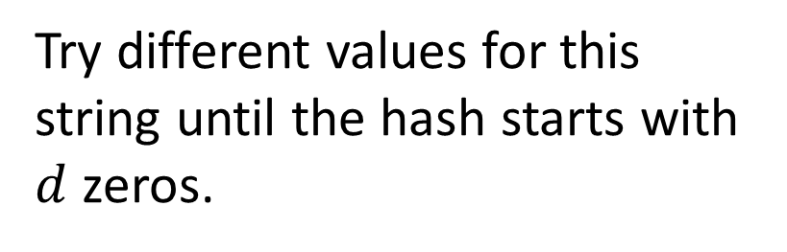
Blocks
If we have a block, we can construct a “next block”:
Take $\text{H}\text{ash}(B′)$ from the previous block$B′$. Add transactions.
$$=$$
Try different values for this string until the hash starts with $d$ zeros.
Notes:
Remark: same color: same string (but should be clear even if you can’t see the color)

Slide 23

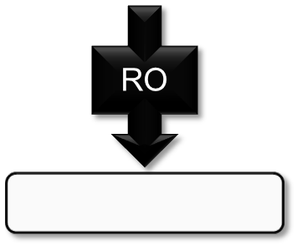
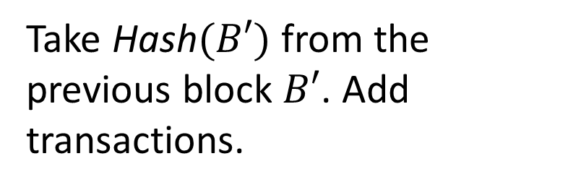

Blocks
If we have a block, we can build a “next block”:
Take $\text{Hash}(B′)$ from the previous block $B′$. Add transactions.
$$=$$
Try different values for this string until the hash starts with $d$ zeros.
Bitcoin chooses $d$ such that this takes ~10 minutes.
Notes:
Remark: same color: same string (but should be clear even if you can’t see the color)

Slide 24
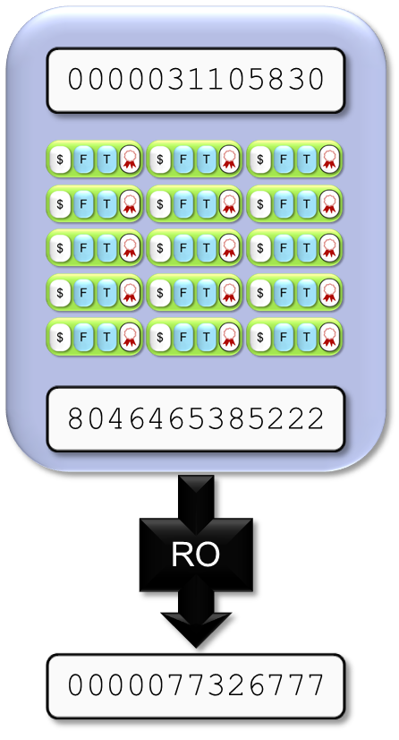
0000053859184
RO
0000053859184

Slide 25
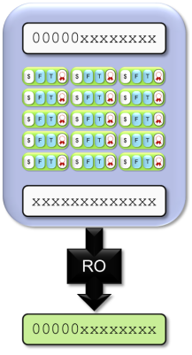

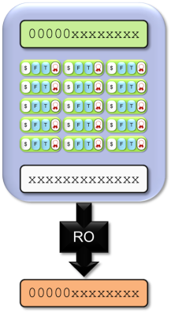
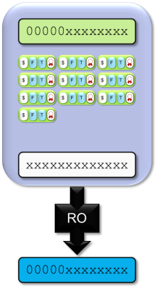
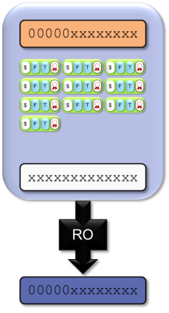
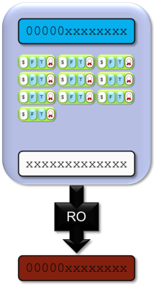
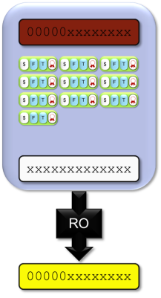
A Tree of Blocks
If we have a block, with a bit of work, we can build a “next block”…
$$=$$
...and yet another “next block”…
…or a block which continues here…
… and so on.
Notes:
Remark: same color: same string (but should be clear even if you can’t see the color)

Slide 26
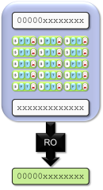

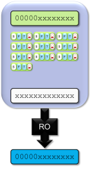

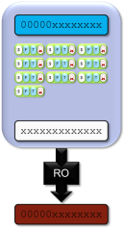
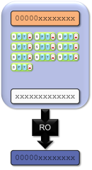
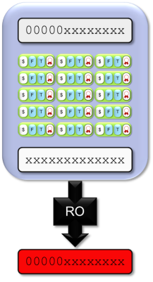
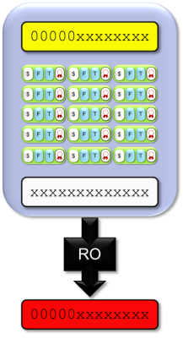

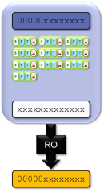
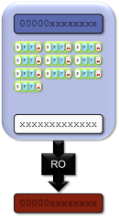
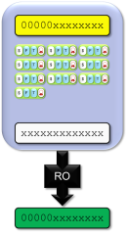

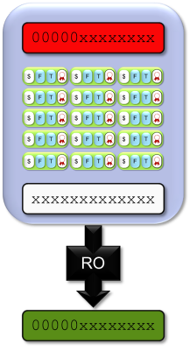
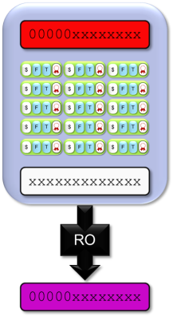
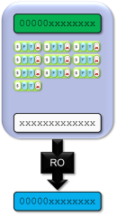
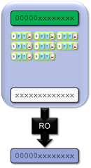
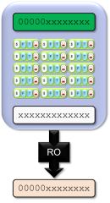
A Tree of Blocks
In general, we can build a tree of blocks like this.
But only ever downwards!

Slide 27
The Protocol for Building Blocks
Protocol: building blocks
Take the longest chain you can find.
Collect transactions.
Build a new valid block here.
Publish it.

Slide 28
The Protocol for Finding Blocks
A transaction is not considered confirmed until:
it is part of a block in the longest fork, and
at least 5 blocks follow it in the longest fork. In this case we say that the transaction has “6 confirmations”.

Slide 29
The Protocol for Participants
Protocol: To know who owns BTC
Take the longest chain you can find.
Process the transactions in this chain in order.

Slide 30
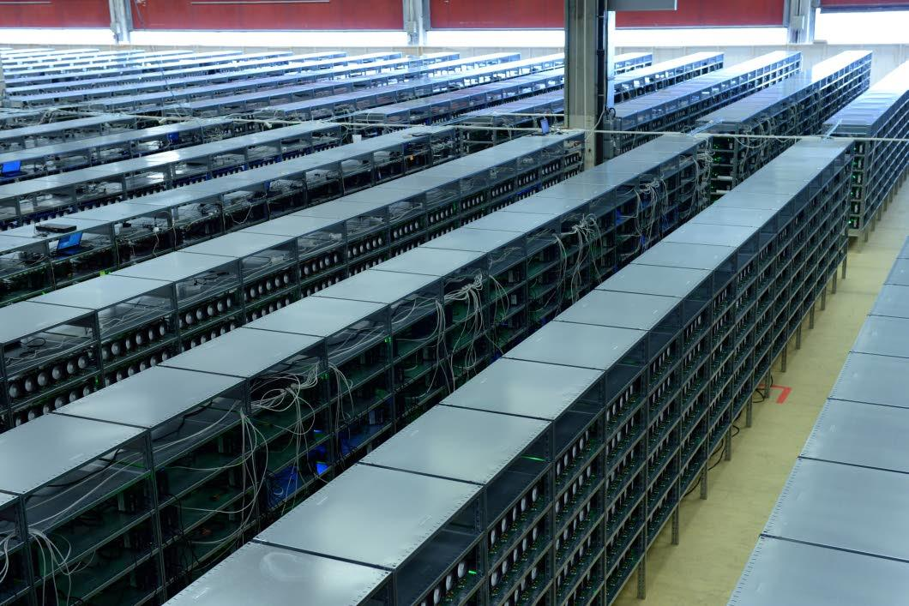
Why work to build blocks?
Many people are trying to build blocks, which uses a lot of resources…
A real lot!
This is called “mining”.

Slide 31
Block reward
If you build a block, you get bitcoins as a reward.
Every transaction specifies a fee. It goes to the person who puts the transaction into a valid block.
0.1 BTC
Transfer
0.1 BTC
Transfer
Alice (Public)
from
Alice (Public)
from
Bob
(Public)
to
Bob
(Public)
to
A
0.001 BTC
Fee:
A

Slide 32
Recap: The Bitcoin Protocol
Protocol: participate
Relay valid transactions.
Relay valid blocks in the longest chain.
Work with the longest chain.
Protocol: miners
Collect valid transactions.
Build and publish valid blocks which extend the longest chain.

Slide 33
Bitcoin’s consensus protocol
Step 1: How does the protocol look like?
Step 2: What happens if people cheat?

Slide 34
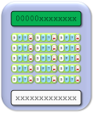
Double Spends
I found a valid block!
I can exploit this!
Bob
Black Hat
Once a block is found, the double spends vanish.
Alice
Occasionally, two people find blocks at around the same time… but the problem disappears eventually.
Notes:
Mention: block finding time ~10m -> we can distribute before a new block is found

Slide 35


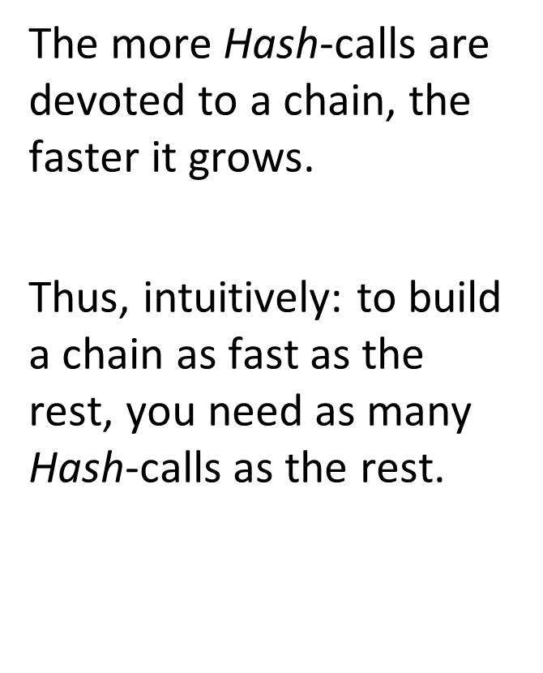
Build an Alternate Chain?
The more$\text{Hash}$-calls are devoted to a chain, the faster it grows.
Thus, intuitively: to build a chain as fast as the rest, you need as many $\text{Hash}$-calls as the rest.
Maybe I should build another chain?
Notes:
Mention: if most people are honest, it should mean that good things happen.
Mention: Theorem due to Garay, Kiayias, Leonardos (Oct 2014) shows: if most hashpower is devoted to honest parties, good things happen.
USE MOUSE FOR NEXT SLIDE

Slide 36
CRDTs or Commutative/Convergent/Conflict-Free Replicated Data Types
http://reed.cs.depaul.edu/lperkovic/csc536/lecture10/techreport.pdf

Slide 37
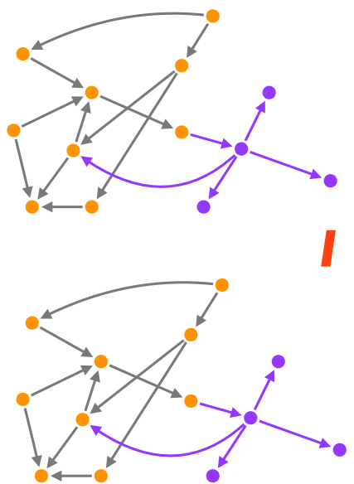
Strong Consistency
Ideal consistency: all replicas know about the update immediately after it executes
Preclude conflicts
Replicas update in the same total order
Consensus
Serialization bottleneck
Tolerates < n/2 faults
Correct, but doesn’t scale

Slide 38
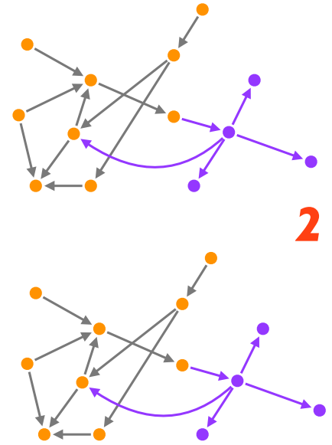
Strong Consistency
Ideal consistency: all replicas know about the update immediately after it executes
Preclude conflicts
Replicas update in the same total order
Consensus
Serialization bottleneck
Tolerates < n/2 faults
Correct, but doesn’t scale

Slide 39
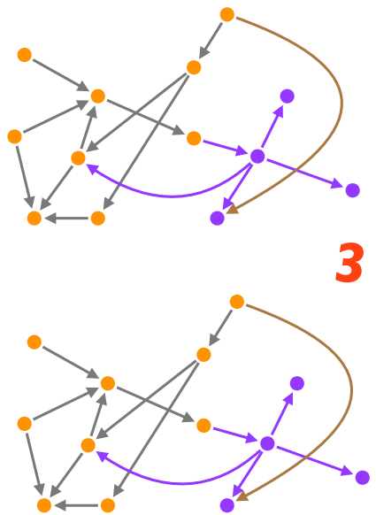
Strong Consistency
Ideal consistency: all replicas know about the update immediately after it executes
Preclude conflicts
Replicas update in the same total order
Consensus
Serialization bottleneck
Tolerates < n/2 faults
Correct, but doesn’t scale

Slide 40
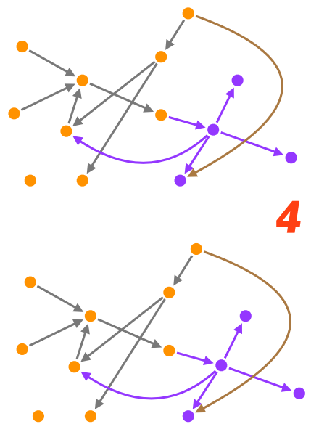
Strong Consistency
Ideal consistency: all replicas know about the update immediately after it executes
Preclude conflicts
Replicas update in the same total order
Consensus
Serialization bottleneck
Tolerates < n/2 faults
Correct, but doesn’t scale

Slide 41
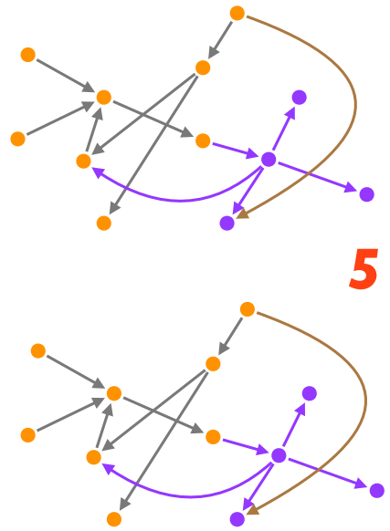
Strong Consistency
Ideal consistency: all replicas know about the update immediately after it executes
Preclude conflicts
Replicas update in the same total order
Consensus
Serialization bottleneck
Tolerates < n/2 faults
Correct, but doesn’t scale

Slide 42
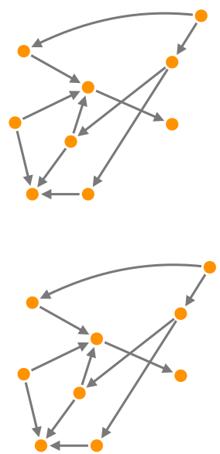
Eventual Consistency
Update local and propagate
No foreground synch
Eventual, reliable delivery
On conflict
Arbitrate
Roll back
Consensus moved to background
Better performance
Still complex

Slide 43
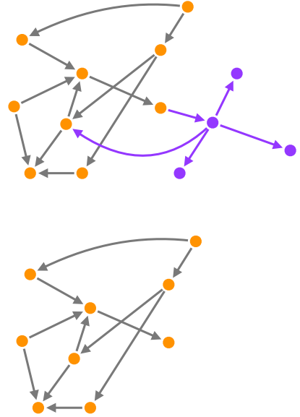
Eventual Consistency
Update local and propagate
No foreground synch
Eventual, reliable delivery
On conflict
Arbitrate
Roll back
Consensus moved to background
Better performance
Still complex

Slide 44
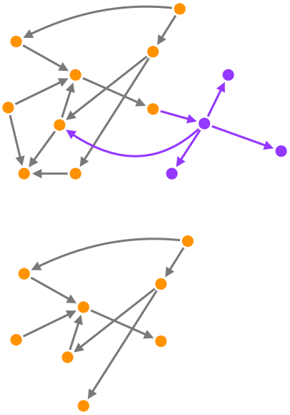
Eventual Consistency
Update local and propagate
No foreground synch
Eventual, reliable delivery
On conflict
Arbitrate
Roll back
Consensus moved to background
Better performance
Still complex

Slide 45
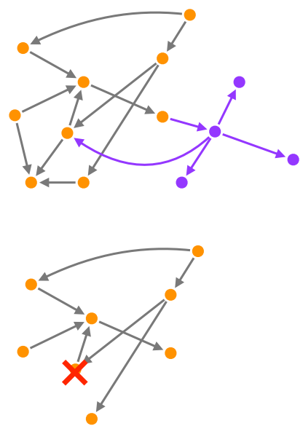
Eventual Consistency
Update local and propagate
No foreground synch
Eventual, reliable delivery
On conflict
Arbitrate
Roll back
Consensus moved to background
Better performance
Still complex

Slide 46
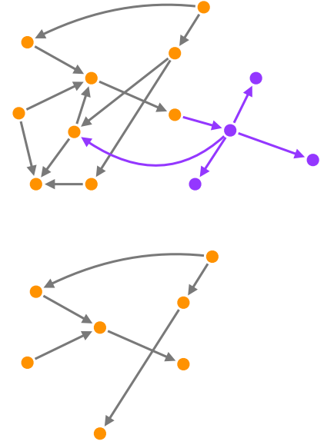
Eventual Consistency
Update local and propagate
No foreground synch
Eventual, reliable delivery
On conflict
Arbitrate
Roll back
Consensus moved to background
Better performance
Still complex

Slide 47

Eventual Consistency
Update local and propagate
No foreground synch
Eventual, reliable delivery
On conflict
Arbitrate
Roll back
Consensus moved to background
Better performance
Still complex

Slide 48

Eventual Consistency
Update local and propagate
No foreground synch
Eventual, reliable delivery
On conflict
Arbitrate
Roll back
Consensus moved to background
Better performance
Still complex
Reconcile

Slide 49

Strong Eventual Consistency
Update local and propagate
No synch
Eventual, reliable delivery
No conflict
deterministic outcome of concurrent updates
No consensus bottleneck
Handles ≤ n-1 faults
Solves the CAP problem

Slide 50

Strong Eventual Consistency
Update local and propagate
No synch
Eventual, reliable delivery
No conflict
deterministic outcome of concurrent updates
No consensus bottleneck
Handles ≤ n-1 faults
Solves the CAP problem

Slide 51

Strong Eventual Consistency
Update local and propagate
No synch
Eventual, reliable delivery
No conflict
deterministic outcome of concurrent updates
No consensus bottleneck
Handles ≤ n-1 faults
Solves the CAP problem

Slide 52

Strong Eventual Consistency
Update local and propagate
No synch
Eventual, reliable delivery
No conflict
deterministic outcome of concurrent updates
No consensus bottleneck
Handles ≤ n-1 faults
Solves the CAP problem

Slide 53

Strong Eventual Consistency
Update local and propagate
No synch
Eventual, reliable delivery
No conflict
deterministic outcome of concurrent updates
No consensus bottleneck
Handles ≤ n-1 faults
Solves the CAP problem

Slide 54
Definition of EC
Eventual delivery: An update delivered at some correct replica is eventually delivered to all correct replicas
Termination: All method executions terminate
Convergence: Correct replicas that have delivered the same updates eventually reach equivalent state
By potentially doing roll backs and reconciling

Slide 55
Definition of SEC
Eventual delivery: An update delivered at some correct replica is eventually delivered to all correct replicas
Termination: All method executions terminate
Strong Convergence: Correct replicas that have delivered the same updates have equivalent state

Slide 56

State-based approach
An object is a tuple $(S,s^{0},q,u,m)$
Local queries, local updates
Possible preconditions
Evaluate synchronously, no side effects
Send full state; on receive, merge
Update is said ‘delivered’ at some replica when it is included in its causal history
Causal History:
C$=\left[c_{1},…,c_{n}\right] (where c_{i} goes through a sequence of states c_{i}^{0},{…,c}_{i}^{k}…)$
payload set
merge
initial state
update
query

Slide 57

Query
Client sends the query to any of the replicas
Local at source replica
Evaluate synchronously, no side effects

Slide 58

Query
Client sends the query to any of the replicas
Local at source replica
Evaluate synchronously, no side effects

Slide 59

Query
Client sends the query to any of the replicas
Local at source replica
Evaluate synchronously, no side effects

Slide 60



State-based replication
Local at source $s_{1}$.u(a), $s_{2}$.u(b), …
Precondition, compute
Update local payload
Causal History:
on query: $c_{i}^{k}=c_{i}^{k−1}$
on update: $c_{i}^{k}=c_{i}^{k−1}∪\{u_{i}^{k}\left(a\right)\}$

Slide 61


State-based replication
Local at source $s_{1}$.u(a), $s_{2}$.u(b), …
Precondition, compute
Update local payload
Causal History:
on query: $c_{i}^{k}=c_{i}^{k−1}$
on update: $c_{i}^{k}=c_{i}^{k−1}∪\{u_{i}^{k}\left(a\right)\}$

Slide 62



State-based replication
Local at source $s_{1}$.u(a), $s_{2}$.u(b), …
Precondition, compute
Update local payload
Convergence
Episodically: send $s_{i}$ payload
On delivery: merge payloads
Causal History:
on query: $c_{i}^{k}=c_{i}^{k−1}$
on update: $c_{i}^{k}=c_{i}^{k−1}∪\{u_{i}^{k}\left(a\right)\}$
on merge: $c_{i}^{k}=c_{i}^{k−1}∪c_{i′}^{k′}$

Slide 63

State-based replication
Local at source $s_{1}$.u(a), $s_{2}$.u(b), …
Precondition, compute
Update local payload
Convergence
Episodically: send $s_{i}$ payload
On delivery: merge payloads
Causal History:
on query: $c_{i}^{k}=c_{i}^{k−1}$
on update: $c_{i}^{k}=c_{i}^{k−1}∪\{u_{i}^{k}\left(a\right)\}$
on merge: $c_{i}^{k}=c_{i}^{k−1}∪c_{i′}^{k′}$

Slide 64

State-based replication
Local at source $s_{1}$.u(a), $s_{2}$.u(b), …
Precondition, compute
Update local payload
Convergence
Episodically: send $s_{i}$ payload
On delivery: merge payloads
Causal History:
on query: $c_{i}^{k}=c_{i}^{k−1}$
on update: $c_{i}^{k}=c_{i}^{k−1}∪\{u_{i}^{k}\left(a\right)\}$
on merge: $c_{i}^{k}=c_{i}^{k−1}∪c_{i′}^{k′}$

Slide 65

Semi-lattice
A poset $(S,≤)$ is a join-semi-lattice if for all x,y in S an LUB $x⊔y$exists
$∀x,y∈S, ∃z=x⊔y such that x,y≤z and ∄z^{′}:x,y≤z^{′}<z$
LUB = Least Upper Bound is something that satisfies these:
Associative: $x⊔\left(y⊔z\right)=(x⊔y)⊔z$
Commutative: $x⊔y=y⊔x$
Idempotent: $x⊔x=x$
Examples:
$\left(int,≤\right): x⊔y=max⁡(x,y)$
$\left(sets,⊆\right): x⊔y=x∪y$

Slide 66


State-based: monotonic semi-lattice CvRDT
If:
then replicas converge to LUB of last values
payload type forms a semi-lattice
updates are increasing
merge computes Least Upper Bound

Slide 67

Operation-based approach
An object is a tuple $(S,s^{0},q,t,u,P)$
prepare-update
Precondition at source
1st phase: at source, synchronous, no side effects
effect-update
Precondition against downstream state (P)
2nd phase, asynchronous, side-effects to downstream state
payload set
delivery precondition
initial state
effect-update
query
prepare-update

Slide 68


Operation-based replication
Local at source
Precondition, compute
Broadcast to all replicas
Causal History:
on query/prepare-update: $c_{i}^{k}=c_{i}^{k−1}$

Slide 69


Operation-based replication
Local at source
Precondition, compute
Broadcast to all replicas
Eventually, at all replicas:
Downstream precondition
Assign local replica
Causal History:
on query/prepare-update: $c_{i}^{k}=c_{i}^{k−1}$
on effect-update: $c_{i}^{k}=c_{i}^{k−1}∪\{u_{i}^{k}\left(a\right)\}$

Slide 70

Operation-based replication
Local at source
Precondition, compute
Broadcast to all replicas
Eventually, at all replicas:
Downstream precondition
Assign local replica
Causal History:
on query/prepare-update: $c_{i}^{k}=c_{i}^{k−1}$
on effect-update: $c_{i}^{k}=c_{i}^{k−1}∪\{u_{i}^{k}\left(a\right)\}$

Slide 71


Op-based: commute CmRDT
Liveness: all replicas execute all operations in delivery order where the downstream precondition (P) is true
Safety: concurrent operations all commute
If:
then replicas converge

Slide 72
Monotonic semi-lattice = Commutative
A state-based object can emulate an operation-based object, and vice-versa
Use state-based reasoning and then covert to operation based for better efficiency

Slide 73
CRDTs
Op-based: Simple counter
State-Based: Multi-master counter
Op-Based: Observed-Remove Set

Slide 74
Op-based: Simple counter
Payload: P = int, initial value 0
Query: value () : P[i]
Update: increment () i := i + 1
Update: decrement () i := i − 1
Both update operations commute
So Simple Counter is a valid CmRDT

Slide 75
State-based: Counter --- Problem
A state-based counter is not as straightforward.
To see the problem in a simple setting, consider a Counter that only increments.
Possible solution 1: the payload is an integer and merge adds the two values.
This is not a CvRDT, as merge is not idempotent.
Possible solution 2: the payload is a single integer and merge computes max.
This data type is a CvRDT as its states form a monotonic semi-lattice.
However: Consider two replicas, with the same initial state of 0; at each one, a client originates increment. They converge to 1 instead of the expected 2.

Slide 76

State-based: Multi-master counter
Increment
Payload: $P=[int,int,…]$
Partial order: $x≤y \overset{⇔}{}∀i x\left[i\right]≤y[i]$
value() = $\sum_{i}{P[i]}$
increment() = $P\left[MyID\right]$++
merge(x,y) = $x⊔y$ = $[…,max\left(x.P\left[i\right],y.P\left[i\right]\right),…]$

Slide 77

State-based: Multi-master counter
Increment / Decrement
Payload: $P=\left[int,int,…\right]$ , $N=\left[int,int,…\right]$
Partial order: $x≤y \overset{⇔}{}∀i x\left[i\right]≤y[i]$
value() = $\sum_{i}{P[i]}$ - $\sum_{i}{N[i]}$
increment() = $P\left[MyID\right]$++
decrement() = $N\left[MyID\right]$++
merge(x,y) = $x⊔y$ = ( $\left[…,max\left(x.P\left[i\right],y.P\left[i\right]\right),…\right] ,$
$\left[…,max\left(x.N\left[i\right],y.N\left[i\right]\right),…\right]$ )

Slide 78
Set design alternatives
Sequential specification:
{true} add(e) {e in S}
{true} remove(e) {e not in S}
Concurrent: {true} add(e) ║ remove(e) {???}
linearizable?
error state?
last writer wins?
add wins?
remove wins?

Slide 79

Observed-Remove Set

Slide 80


Observed-Remove Set
Payload: added, removed (element, unique token)
add(e) = $A≔A ∪\{\left(e,α\right)\}$

Slide 81

Observed-Remove Set
Payload: added, removed (element, unique token)
add(e) = $A≔A ∪\{\left(e,α\right)\}$

Slide 82

Observed-Remove Set
Payload: added, removed (element, unique token)
add(e) = $A≔A ∪\{\left(e,α\right)\}$

Slide 83

Observed-Remove Set
Payload: added, removed (element, unique token)
add(e) = $A≔A ∪\{\left(e,α\right)\}$

Slide 84


Observed-Remove Set
Payload: added, removed (element, unique token)
add(e) = $A≔A ∪\left\{\left(e,α\right)\right\}$
Remove all unique elements observed: remove(e) = $R≔R∪\left\{\left(e,−\right)∈A\right\}$
lookup(e) = $∃ \left(e,−\right)∈A \backslash R$
merge(S,S’) = $(A∪A^{′},R∪R^{′})$

Slide 85

Observed-Remove Set
Payload: added, removed (element, unique token)
add(e) = $A≔A ∪\left\{\left(e,α\right)\right\}$
Remove all unique elements observed: remove(e) = $R≔R∪\left\{\left(e,−\right)∈A\right\}$
lookup(e) = $∃ \left(e,−\right)∈A \backslash R$
merge(S,S’) = $(A∪A^{′},R∪R^{′})$

Slide 86


Observed-Remove (OR) Set
Payload: added, removed (element, unique token)
add(e) = $A≔A ∪\left\{\left(e,α\right)\right\}$
Remove all unique elements observed: remove(e) = $R≔R∪\left\{\left(e,−\right)∈A\right\}$
lookup(e) = $∃ \left(e,−\right)∈A \backslash R$
merge(S,S’) = $(A∪A^{′},R∪R^{′})$

Slide 87
Real-world use
Support for CRDTs is implemented in Riak (Counter, Register, Set, Map, …)
League of Legends uses the Riak CRDT implementation for its in-game chat system, which handles 7.5 million concurrent users and 11,000 messages per second.
Bet365 (the largest European on-line betting company with 2.5 million simultaneous users peak), store hundreds of megabytes of data in the Riak implementation of OR-Set.
SoundCloud open-sourced Roshi, a LWW-element-set CRDT for the SoundCloud stream implemented on top of Redis.
TomTom employs a variation of the OR-Set CRDT to synchronize favorite location navigation data between the devices of a user.

Slide 88
CRDTs in Akka Cluster
Akka Distributed Data is used when you need to share data between nodes in an Akka Cluster
The data is accessed with an actor at each node providing a key-value store like API
The keys are unique identifiers of the data values
The values are Conflict Free Replicated Data Types (CRDTs)
All data updates are spread to all nodes, or nodes with a certain role, in the cluster via gossip based dissemination
The nature of CRDTs makes it possible to perform updates from any node
Concurrent updates from different nodes will automatically be resolved by the monotonic merge function, which all data types must provide
Several useful data types for counters, sets, maps and registers are provided and you can also implement your own custom data types
The replica consistency model is eventually consistent and geared toward providing high read and write availability (partition tolerance), with low latency

Slide 89
Summary
Key approach
Strong Eventual Consistency
Two sufficient conditions:
State: monotonic semi-lattice
Operation: commutativity
Useful CRDTs
Multi-master counter, OR-Set, Directed Graph

